Slide 1
Photovoltaic and Solar Power Forecasting for Smart Energy Grid Management
- Viraj Kamat

Slide 2
Need for Solar Power Forecasting
Climate change is the motivation for alternate sources of energy
Solar energy is a prominent source of power generation
PV power is reaching high penetration in smart grid but introduces volatility
Prediction can help improve electric power delivered, reduce ancillary costs
We employ statistical, AI, physical & hybrid approach models in our predictions

Slide 3
Characteristics of Solar Forecasting
Solar forecasting predicts solar irradiance or PV generation
PV power generation is affected by many factors such as cell area, temperature, etc
We wish to find MPPT of a PV array, given as: PR = ηSI [1 − 0.05(t₀ − 25)]
Prediction depends on historical measurements and NWP (numerical weather predictors)
We wish to predict for different prediction horizons, namely short-term to long-term horizons based on the need

Slide 4

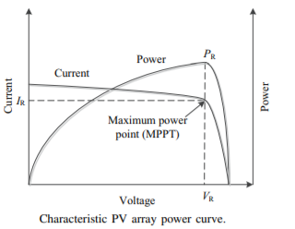
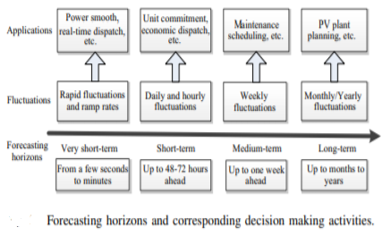

Slide 5
Statistical Models
The persistence model is the simplest model, it refers to previous timesteps for prediction
ARMA is another model that works upon auto-correlated time series data to make future predictions. Used to predict future solar generation in California.
ARMA has limitations, it is applied upon a constantly changing time series data. We employ ARIMA which computes a mean of the statistical properties of the data.
If we include exogenous inputs into ARIMA for PV generation forecasting we get ARMAX which has higher accuracy.

Slide 6
Artificial Intelligence Models
AI techniques are employed due to high learning and better regression capabilities
Artificial neural networks can approximate non-linear mapping can happen to any degree of accuracy
ANN’s employ neurons with mathematical activation function that take in multidimensional data to perform predictions.
ANN’s with back-propagation is widely used in performing predictions that prevent overfitting
While ANN’s predict short-term solar irradiance, MLP(Multilayer perception models) are used to predict solar irradiance for the 24h format.

Slide 7
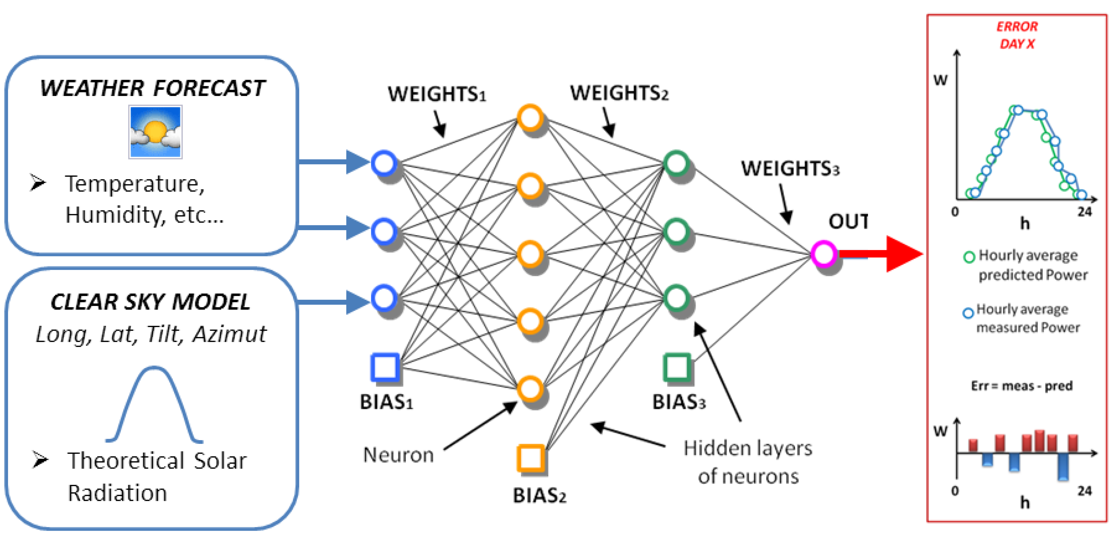
An Artificial Neural Network Model

Slide 8
Physical & Hybrid Models
Physical models rely on weather data and current state of PV generators to make predictions of solar irradiance.
Sky imaging systems using satellites and infrared scanners provide good temporal & spatial resolution of cloud cover.
Large scale PV generation plants could benefit from detecting sudden changes in solar irradiance
Numerical models require precise details on the current state of the atmosphere
NWP provide lookup for upto 15 days. Data of atmosphere, coupled with satellite imagery is used with governing laws of physics.

Slide 9
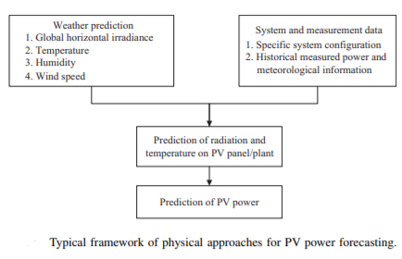
Block diagram of a physical model for PV generation prediction

Slide 10
Applications in Smart Energy Grid
The large scale integration of PV generation has called for smart energy-grid management
PV generation has problems of voltage fluctuation, power flow, grid losses, short-circuit current of distribution networks.
Predicting PV generation is helpful for system operators, city energy decision makers
With the use of predictions we can smooth out the voltage and frequency of PV based smart-energy grids. System operators can make informed decisions.
These include double layer capacitors, fast ramping generators, battery storage systems that activate as PV output fluctuates.

Slide 11
Conclusion
We have explored the need for Smart Energy in PV generation
We have explored different models used to predict PV generation
We now have an understanding of how weather predictors along with PV prediction helps build energy smart cities.
More work is being done to integrate existing models together to provide more precise PV predictions.

Slide 12
References
https://ieeexplore.ieee.org/abstract/document/7377167
https://www.youtube.com/watch?v=3UmyHed0iYE
https://www.youtube.com/watch?v=HhvTlaN06AM
https://towardsdatascience.com/how-machine-learning-can-transform-the-energy-industry-caaa965e282a

